Slide 1

Session Name:
Numerical Optimization
Evolutionary Algorithms and Numerical Optimization
Delivered By:
Vikash Singh
Notes:
Opening: Frame the class as a practical session on how businesses choose the best possible decision under limitations.

Slide 2

Guidelines
Tips to be more interactive in Live Session
Maintain discipline for smooth conductance of the interactive live session.
Type in your Name, UID and Program name on chat to mark your attendance.
Raise your questions only after completion of session and do not intervene in between.
Avoid posting irrelevant questions. Also, don’t start any personalized conversation.
Interaction with faculty should be constructive, and no disruptive comment is appreciated.
For any issues, please contact our academic support service @ 9520954727 or post your queries on srm@onlinevgu.com.
Notes:
Ask students to type one business decision where optimization may help: pricing, inventory, staffing, route planning, advertising budget.

Slide 3

Learning Objectives
By the end of this session, you will be able to:
Define optimization and explain why it matters in business decisions.
Formulate an optimization problem using decision variables, objective function and constraints.
Differentiate optimization from constraint satisfaction problems.
Solve simple numerical examples for linear and nonlinear optimization.
Identify when a problem is linear versus nonlinear.
Notes:
Tell students that this lecture builds the foundation for evolutionary algorithms: before searching for an optimum, we must define what optimum means.

Slide 4

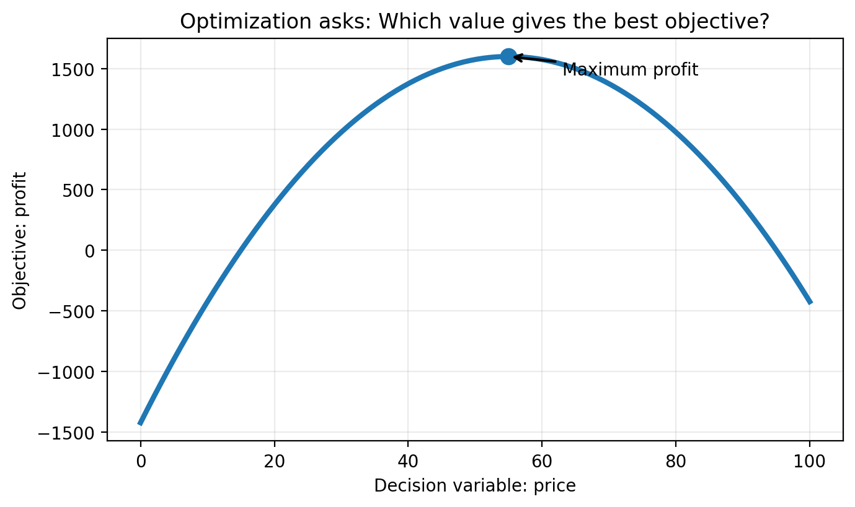
1. Introduction to Optimization
A structured way to choose the best option under given limitations
Optimization = making the best possible decision
We have choices: price, quantity, budget, schedule, allocation, route.
We have a goal: maximize profit, minimize cost, reduce waiting time, improve accuracy.
We have limits: budget, capacity, time, resources, policy, service levels.
Optimization converts a messy business decision into a solvable mathematical model.
Manager’s question: “Which decision gives the best outcome?”
Optimizer’s answer: “Let us define best, then search systematically.”
Notes:
Emphasize best is always with respect to an objective. Different objectives can lead to different optimal decisions.

Slide 5
Where Optimization Shows Up in Business
Same logic, different domains
Pricing
Inventory
Staffing
Logistics
Marketing
Business area
Decision variable
Objective
Typical constraint
Pricing
Price / discount
Maximize revenue or margin
Demand response, competition
Inventory
Order quantity
Minimize stockout + holding cost
Warehouse capacity, cash
Staffing
Number of agents per shift
Minimize wait time / cost
Labour hours, SLA
Marketing
Budget by channel
Maximize leads / ROI
Total budget, reach, risk
Notes:
Invite students to identify decision variable, objective and constraint in one of the listed examples.

Slide 6
Where Optimization Shows Up in Business
Same logic, different domains
Pricing
Inventory
Staffing
Logistics
Marketing
Business area
Decision variable
Objective
Typical constraint
Pricing
Price / discount
Maximize revenue or margin
Demand response, competition
Inventory
Order quantity
Minimize stockout + holding cost
Warehouse capacity, cash
Staffing
Number of agents per shift
Minimize wait time / cost
Labour hours, SLA
Marketing
Budget by channel
Maximize leads / ROI
Total budget, reach, risk
Optimization is a decision framework: it forces clarity on choices, goals and limits before calculation begins.
Notes:
Invite students to identify decision variable, objective and constraint in one of the listed examples.

Slide 7

2. Mathematical Formulation — Simple View
Optimization means selecting the best possible decision within given limits.
Every optimization problem answers one practical question:
“What should we choose so that the result is best?”
1
Decision Variable
2
Objective
3
Constraints
What can we control? Example: number of units to produce.
What do we want? Maximize profit or minimize cost.
What limits us? Budget, time, capacity, demand.
Choose x → Maximize / Minimize f(x) → Subject to limits
Best answer = best feasible decision

Slide 8
Mini Example: Turning Business Language into Math
A factory makes Product A and Product B. The manager wants the most profitable production plan.
Business Problem
How many units of A and B should we produce?
Goal: maximize profit
Limits: machine time and demand

Slide 9
Mini Example: Turning Business Language into Math
A factory makes Product A and Product B. The manager wants the most profitable production plan.
Business Problem
Mathematical Model
How many units of A and B should we produce?
Let x = units of Product A, y = units of Product B
Maximize Profit = 40x + 30y
Goal: maximize profit
Limits: machine time and demand
Subject to:
2x + y ≤ 100 Machine time
x + y ≤ 80 Demand limit
x, y ≥ 0 No negative production
Optimization will find the best mix of A and B that satisfies all limits.

Slide 10
A Simple 5-Step Formulation Method
Use this every time you convert a business problem into mathematics
1. Decision
2. Objective
3. Constraints
4. Bounds
5. Solve & interpret
1. Identify the exact decision to be made: what can the manager change?
2. Write the objective: maximize or minimize what?
3. List all real restrictions: budget, resources, time, capacity, rules.
4. Add non-negativity and practical limits: x ≥ 0, units must be realistic.
5. Solve, then translate the mathematical answer back into business action.
Golden rule: A vague business question produces a vague model. A clear model starts with clear decisions.
Notes:
This slide is intended to be interactive. Give 2 minutes for participants to share examples in chat.

Slide 11
3. Objective Functions: What Does “Best” Mean?
Best is not universal; it depends on the metric chosen
Profit objective: maximize revenue minus cost.
Cost objective: minimize cost while meeting service requirements.
Risk objective: minimize volatility, default risk, delays or failures.
Accuracy objective: minimize error, maximize F1-score, improve prediction quality.
Multi-objective trade-off: balance more than one goal, such as profit and fairness.
Notes:
Mention that the objective function defines success. In interviews and consulting projects, unclear objectives are a common failure point.

Slide 12
3. Objective Functions: What Does “Best” Mean?
Best is not universal; it depends on the metric chosen
Profit objective: maximize revenue minus cost.
Cost objective: minimize cost while meeting service requirements.
Risk objective: minimize volatility, default risk, delays or failures.
Accuracy objective: minimize error, maximize F1-score, improve prediction quality.
Multi-objective trade-off: balance more than one goal, such as profit and fairness.
Maximize: Profit = Revenue − Cost
Minimize: Total Cost = Fixed Cost + Variable Cost
Minimize: Error = Σ(actual − predicted)²
Common objective functions are business KPIs written mathematically.
Notes:
Mention that the objective function defines success. In interviews and consulting projects, unclear objectives are a common failure point.

Slide 13
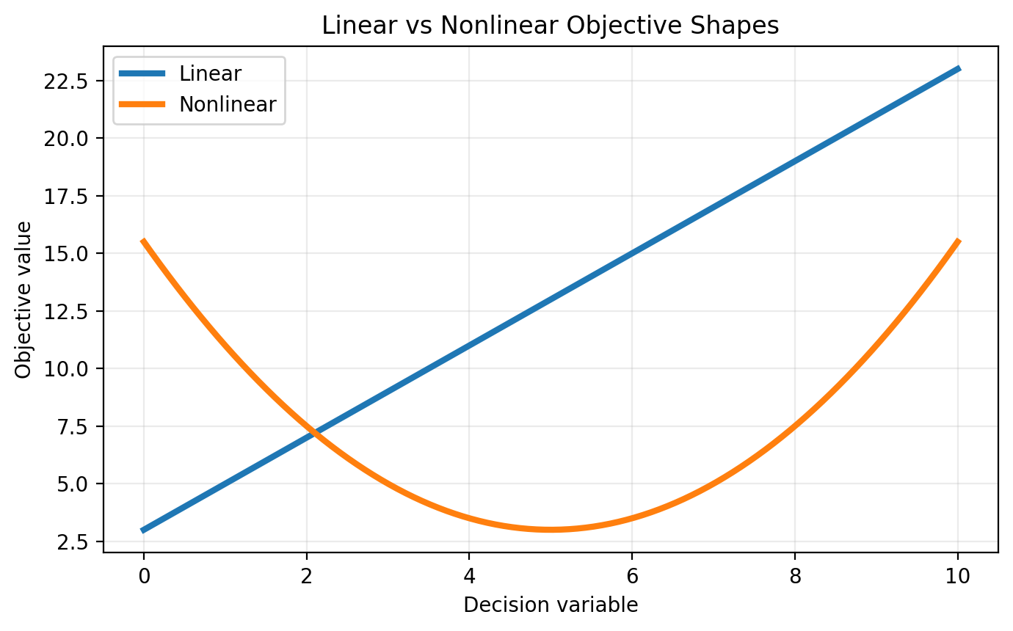
3. Objective Functions: What Does “Best” Mean?
Best is not universal; it depends on the metric chosen
Profit objective: maximize revenue minus cost.
Cost objective: minimize cost while meeting service requirements.
Risk objective: minimize volatility, default risk, delays or failures.
Accuracy objective: minimize error, maximize F1-score, improve prediction quality.
Multi-objective trade-off: balance more than one goal, such as profit and fairness.
Maximize: Profit = Revenue − Cost
Minimize: Total Cost = Fixed Cost + Variable Cost
Minimize: Error = Σ(actual − predicted)²
Same decision. Different objective. Different answer.
A profit-maximizing decision may not be the same as a risk-minimizing decision.
Common objective functions are business KPIs written mathematically.
Notes:
Mention that the objective function defines success. In interviews and consulting projects, unclear objectives are a common failure point.

Slide 14
Constraints: The Reality Check in Optimization
Constraints make the model useful and realistic
Constraint type
Meaning
Example
Inequality
Maximum or minimum limit
Budget ≤ ₹10 lakh
Equality
Exact balance required
Supply = Demand
Bound
Allowed range of decision
0 ≤ Discount ≤ 30%
Integer / binary
Whole-number or yes/no decision
Open warehouse: 0 or 1
Feasible solution = any solution that satisfies all constraints
Infeasible problem = no solution satisfies all constraints
Business insight: Constraints often matter more than the objective. A beautiful model with missing constraints can recommend impossible decisions.
Constraints define the boundary of what is possible.
Notes:
Use examples: you cannot schedule employees beyond labour rules; you cannot allocate more budget than available.

Slide 15
Numerical Example 1: Product Mix Formulation
Convert a small production decision into a linear optimization model
A firm makes Product A and Product B.
Profit per unit: A = ₹40, B = ₹30.
Machine hours: A uses 2 hours, B uses 1 hour; total ≤ 100.
Labour hours: A uses 1 hour, B uses 2 hours; total ≤ 80.
Question: how many units of A and B should be produced?
Notes:
Pause after problem statement; ask learners to identify decision variables before showing the formulation.

Slide 16
Numerical Example 1: Product Mix Formulation
Convert a small production decision into a linear optimization model
A firm makes Product A and Product B.
Profit per unit: A = ₹40, B = ₹30.
Machine hours: A uses 2 hours, B uses 1 hour; total ≤ 100.
Labour hours: A uses 1 hour, B uses 2 hours; total ≤ 80.
Question: how many units of A and B should be produced?
Let x = units of A, y = units of B
Maximize Z = 40x + 30y
Subject to:
2x + y ≤ 100
x + 2y ≤ 80
x ≥ 0, y ≥ 0
This is a Linear Programming problem.
Notes:
Pause after problem statement; ask learners to identify decision variables before showing the formulation.

Slide 17
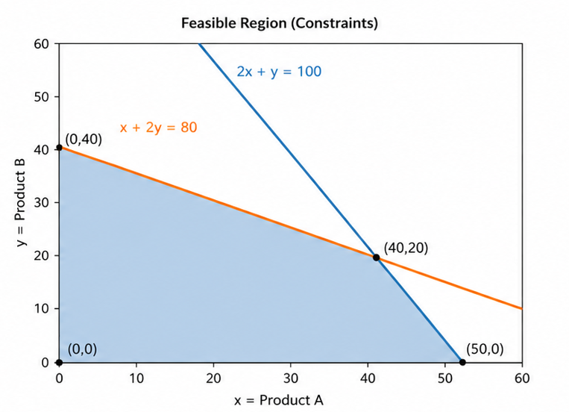
Numerical Example 1: Product Mix Formulation
Convert a small production decision into a linear optimization model
A firm makes Product A and Product B.
Profit per unit: A = ₹40, B = ₹30.
Machine hours: A uses 2 hours, B uses 1 hour; total ≤ 100.
Labour hours: A uses 1 hour, B uses 2 hours; total ≤ 80.
Question: how many units of A and B should be produced?
Let x = units of A, y = units of B
Maximize Z = 40x + 30y
Subject to:
2x + y ≤ 100
x + 2y ≤ 80
x ≥ 0, y ≥ 0
This is a Linear Programming problem.
Notes:
Pause after problem statement; ask learners to identify decision variables before showing the formulation.

Slide 18
Numerical Example 1: Solving by Corner Points
For a linear objective over a polygon, check the corners
Corner point
Z = 40x + 30y
Value
(0, 0)
40(0) + 30(0)
0
(50, 0)
40(50) + 30(0)
2,000
(0, 40)
40(0) + 30(40)
1,200
(40, 20)
40(40) + 30(20)
2,200
Optimal solution: x = 40 units of A and y = 20 units of B.
Maximum profit = ₹2,200.
Notes:
Explain that graphical solution works neatly for two variables. Larger models use algorithms such as simplex or interior point methods.

Slide 19
Academic Poll 1: Check Your Concept
Which component of an optimization model represents the quantity we can control?
A. Objective function
B. Decision variable
C. Constraint
D. Feasible region
Notes:
Use as a live poll. Ask students to answer in chat before revealing the explanation.

Slide 20
Academic Poll 1: Check Your Concept
Which component of an optimization model represents the quantity we can control?
A. Objective function
Answer: B — Decision variable
Explanation: It is the input we choose or control, such as price, units produced, budget allocation or staff count.
B. Decision variable
C. Constraint
D. Feasible region
Notes:
Use as a live poll. Ask students to answer in chat before revealing the explanation.

Slide 21
Objective Functions vs Constraints
The objective is what you improve; constraints are what you obey
Aspect
Objective Function
Constraint
Role
Defines the goal to maximize/minimize
Defines limits or rules
Business meaning
What success means
What is possible or allowed
Example
Maximize profit = 40x + 30y
2x + y ≤ 100 machine hours
Can be multiple?
Yes, but often combined or prioritized
Usually many constraints
Notes:
Have students create two sentences: one that is an objective and one that is a constraint.

Slide 22
Objective Functions vs Constraints
The objective is what you improve; constraints are what you obey
Aspect
Objective Function
Constraint
Role
Defines the goal to maximize/minimize
Defines limits or rules
Business meaning
What success means
What is possible or allowed
Example
Maximize profit = 40x + 30y
2x + y ≤ 100 machine hours
Can be multiple?
Yes, but often combined or prioritized
Usually many constraints
Quick test: In “maximize sales under ₹10 lakh budget,” ??? is the objective; ??? is the constraint.
Notes:
Have students create two sentences: one that is an objective and one that is a constraint.

Slide 23
Objective Functions vs Constraints
The objective is what you improve; constraints are what you obey
Aspect
Objective Function
Constraint
Role
Defines the goal to maximize/minimize
Defines limits or rules
Business meaning
What success means
What is possible or allowed
Example
Maximize profit = 40x + 30y
2x + y ≤ 100 machine hours
Can be multiple?
Yes, but often combined or prioritized
Usually many constraints
Quick test: In “maximize sales under ₹10 lakh budget,” sales is the objective; ₹10 lakh is the constraint.
Notes:
Have students create two sentences: one that is an objective and one that is a constraint.

Slide 24
4. Optimization versus Constraint Satisfaction Problems
Both care about constraints; only optimization ranks feasible solutions
Constraint Satisfaction: Find any feasible answer
Optimization: Find the best feasible answer
Question type
Constraint Satisfaction Problem
Optimization Problem
Core question
“Is there a solution?”
“Which solution is best?”
Objective function
Not required
Required
Output
Any feasible solution
Best feasible solution
Example
Can we create a timetable without clashes?
Can we create the lowest-cost timetable without clashes?
Notes:
Use the timetable example: first, no clashes; second, minimize idle time or cost.

Slide 25
4. Optimization versus Constraint Satisfaction Problems
Both care about constraints; only optimization ranks feasible solutions
Constraint Satisfaction: Find any feasible answer
Optimization: Find the best feasible answer
Question type
Constraint Satisfaction Problem
Optimization Problem
Core question
“Is there a solution?”
“Which solution is best?”
Objective function
Not required
Required
Output
Any feasible solution
Best feasible solution
Example
Can we create a timetable without clashes?
Can we create the lowest-cost timetable without clashes?
CSP = feasibility. Optimization = feasibility + performance ranking.
Notes:
Use the timetable example: first, no clashes; second, minimize idle time or cost.

Slide 26
5. Linear Optimization
When the objective and constraints are straight-line relationships
Linear objective: Z = c₁x₁ + c₂x₂ + … + cₙxₙ
Linear constraint: a₁x₁ + a₂x₂ + … + aₙxₙ ≤ b
No powers like x², no products like xy, no ratios like x/y.
All relationships are proportional and additive.
The feasible region is typically a polygon.
Common algorithms: graphical method, simplex method, interior-point methods.
Good for: production mix, transportation, blending, workforce allocation, portfolio with simplified assumptions.
Notes:
Stress that linear does not mean easy for large problems; it means relationship structure is linear.

Slide 27
Academic Poll 2: Linear or Nonlinear?
Identify the model structure
Which expression makes the optimization model nonlinear?
A. Z = 5x + 7y
B. 3x + 2y ≤ 100
C. xy ≤ 50
D. x ≥ 0, y ≥ 0
Notes:
Before revealing the answer, ask learners to explain why option C is different from the others.

Slide 28
Academic Poll 2: Linear or Nonlinear?
Identify the model structure
Which expression makes the optimization model nonlinear?
A. Z = 5x + 7y
Answer: C — xy ≤ 50
Explanation: The product of decision variables creates a curved boundary. That makes the problem nonlinear.
B. 3x + 2y ≤ 100
C. xy ≤ 50
D. x ≥ 0, y ≥ 0
Notes:
Before revealing the answer, ask learners to explain why option C is different from the others.

Slide 29
Nonlinear Optimization
When the model contains curves, interactions or diminishing returns
Nonlinear objective: profit may rise first and fall after a price point.
Nonlinear constraints: risk, capacity, service level or physics may be curved.
Can have local optima: a solution better than nearby points but not necessarily globally best.
Harder to solve, especially with many variables or non-convex landscapes.
Example: Minimize f(x) = x² − 6x + 11
Derivative condition: f′(x) = 0 at an interior optimum
Notes:
Mention price elasticity or ad response curves as intuitive nonlinear business examples.

Slide 30
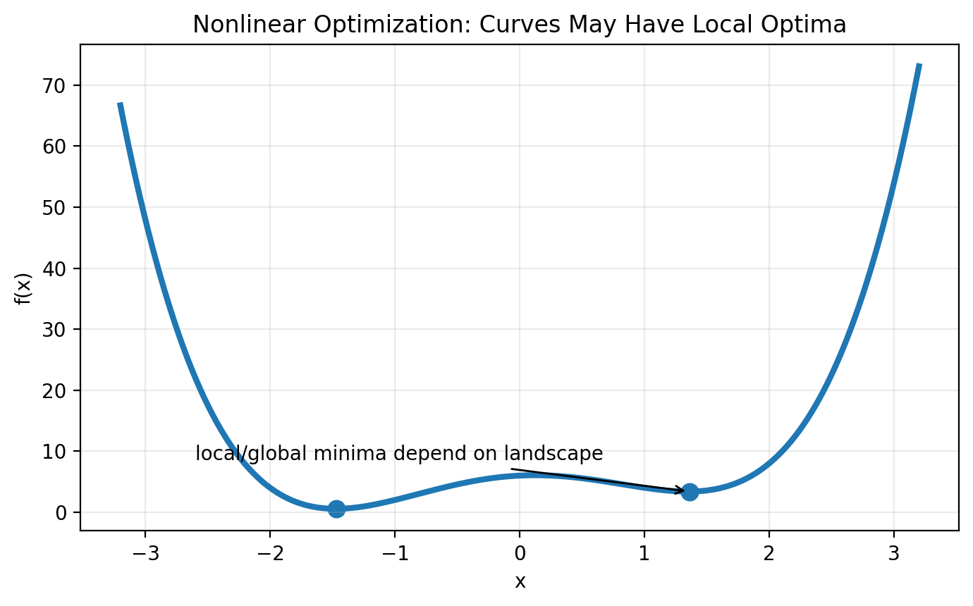
Nonlinear Optimization
When the model contains curves, interactions or diminishing returns
Nonlinear objective: profit may rise first and fall after a price point.
Nonlinear constraints: risk, capacity, service level or physics may be curved.
Can have local optima: a solution better than nearby points but not necessarily globally best.
Harder to solve, especially with many variables or non-convex landscapes.
Example: Minimize f(x) = x² − 6x + 11
Derivative condition: f′(x) = 0 at an interior optimum
Nonlinear ≠ impossible. It means we need methods that understand curvature and local optima.
For smooth single-variable functions, derivative helps locate optima.
Notes:
Mention price elasticity or ad response curves as intuitive nonlinear business examples.

Slide 31
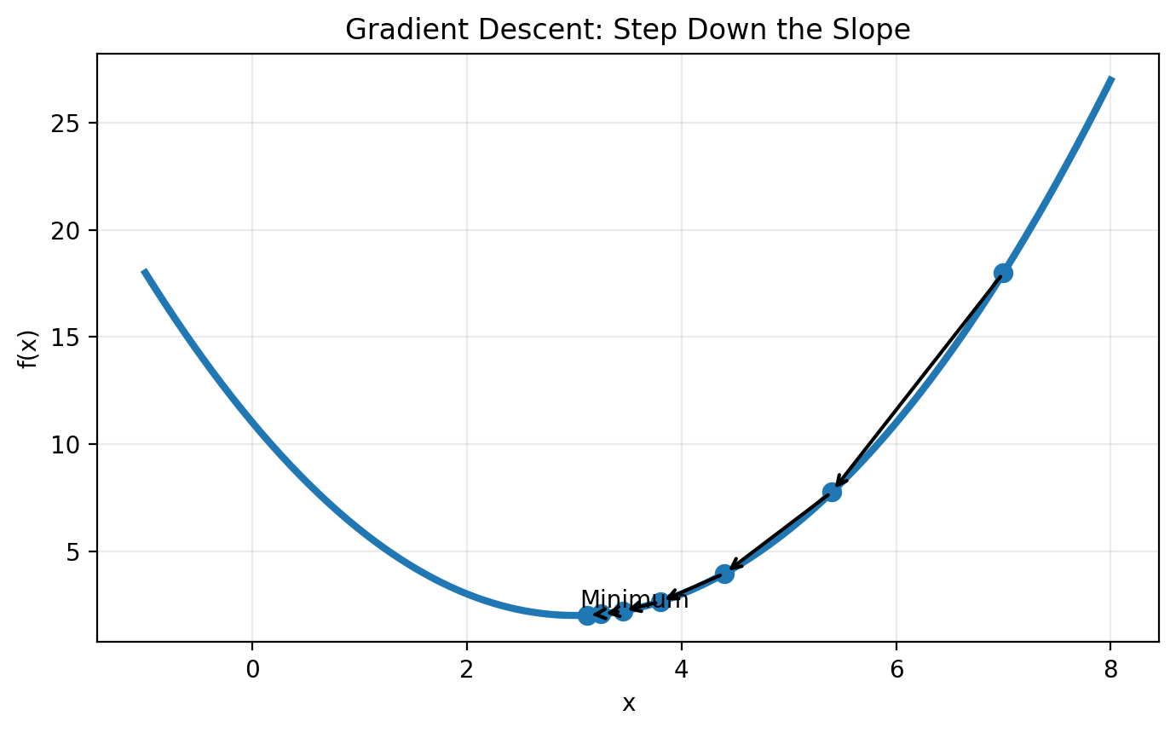
Numerical Example 2: Single-Variable Nonlinear Optimization
Use derivative to find a minimum
Problem: Minimize f(x) = x² − 6x + 11
1. Differentiate: f′(x) = 2x − 6
2. Set derivative to zero: 2x − 6 = 0
3. Solve: x = 3
4. Evaluate: f(3) = 3² − 6(3) + 11 = 2
Minimum value = 2 at x = 3.
Business interpretation: the best value of the decision variable is 3 units.
Gradient intuition: keep moving in the direction that improves the objective until the slope becomes zero or no improvement is possible.
Notes:
This is deliberately simple. The goal is not calculus depth, but showing that slope guides the search.

Slide 32
Linear vs Nonlinear Optimization
A practical comparison for managers and analysts
Dimension
Linear Optimization
Nonlinear Optimization
Relationship
Straight-line, additive
Curved, interactive, complex
Typical geometry
Feasible polygon/polyhedron
Curved feasible region or landscape
Difficulty
Often easier and scalable
Can be harder; local optima possible
Methods
Graphical, simplex, interior point
Gradient methods, Newton, heuristics, evolutionary algorithms
Examples
Transportation, blending, product mix
Pricing response, risk optimization, neural network training
Notes:
This is a summary slide; give students language to use in interviews.

Slide 33
Linear vs Nonlinear Optimization
A practical comparison for managers and analysts
Dimension
Linear Optimization
Nonlinear Optimization
Relationship
Straight-line, additive
Curved, interactive, complex
Typical geometry
Feasible polygon/polyhedron
Curved feasible region or landscape
Difficulty
Often easier and scalable
Can be harder; local optima possible
Methods
Graphical, simplex, interior point
Gradient methods, Newton, heuristics, evolutionary algorithms
Examples
Transportation, blending, product mix
Pricing response, risk optimization, neural network training
Interview-ready answer: Linear optimization assumes proportional/additive relationships. Nonlinear optimization allows curvature and interactions, making it richer but often more challenging.
Notes:
This is a summary slide; give students language to use in interviews.

Slide 34
Practice MCQs: Rapid Fire
Answers are included for classroom discussion
Q1. Which statement is true?
A. Every feasible solution is optimal
B. Every optimal solution is feasible
C. Constraints are optional
D. Objective is same as constraint
Q2. A model with x² in the objective is generally:
A. Linear B. Nonlinear C. CSP only D. No constraint
Q3. In linear programming, if a bounded optimum exists, it usually occurs at:
A. Random point B. Extreme/corner point C. Infeasible region D. Only the origin
Notes:
Use this as a quick recap and ask students to justify answers in their own words.

Slide 35
Practice MCQs: Rapid Fire
Answers are included for classroom discussion
Q1. Which statement is true?
Answer: B. An optimal solution must satisfy all constraints.
A. Every feasible solution is optimal
B. Every optimal solution is feasible
C. Constraints are optional
D. Objective is same as constraint
Q2. A model with x² in the objective is generally:
Answer: B. x² creates curvature.
A. Linear B. Nonlinear C. CSP only D. No constraint
Q3. In linear programming, if a bounded optimum exists, it usually occurs at:
Answer: B. Linear objective contours touch the feasible polygon at a corner/extreme point.
A. Random point B. Extreme/corner point C. Infeasible region D. Only the origin
Notes:
Use this as a quick recap and ask students to justify answers in their own words.

Slide 36

Session Summary
In this session, we have discussed:
Optimization as structured decision-making: best choice under limitations.
Mathematical formulation using decision variables, objective functions and constraints.
Feasible region, optimal solution, equality/inequality/bound constraints.
Difference between constraint satisfaction and optimization problems.
Linear optimization and graphical/corner-point solution logic.
Nonlinear optimization, curvature, derivatives and local/global optima.
Business applications in pricing, staffing, inventory, logistics and marketing.
Notes:
End by asking students to describe one optimization problem from their workplace or daily life.

Slide 37

Notes:
Thank the learners and invite questions.

